Slide 1
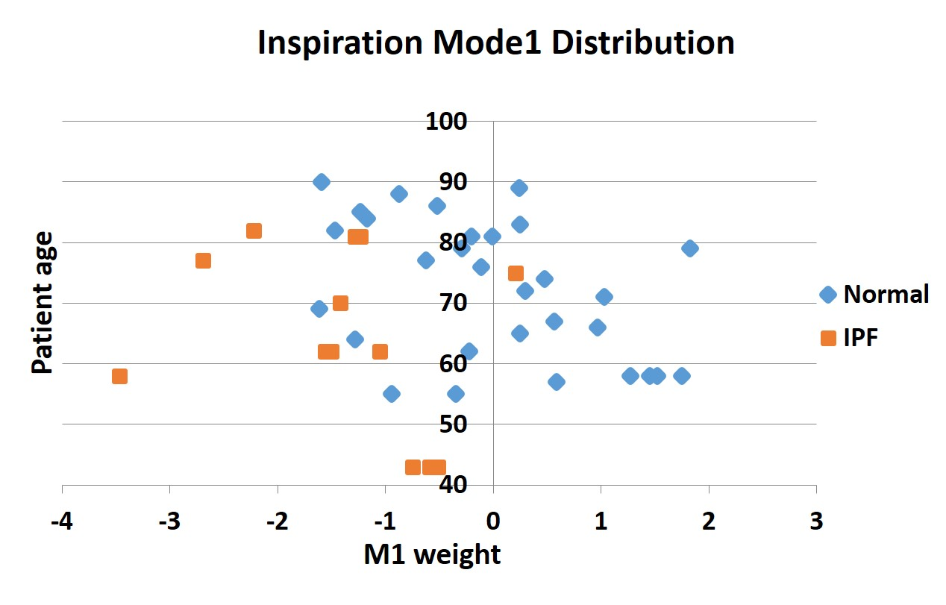
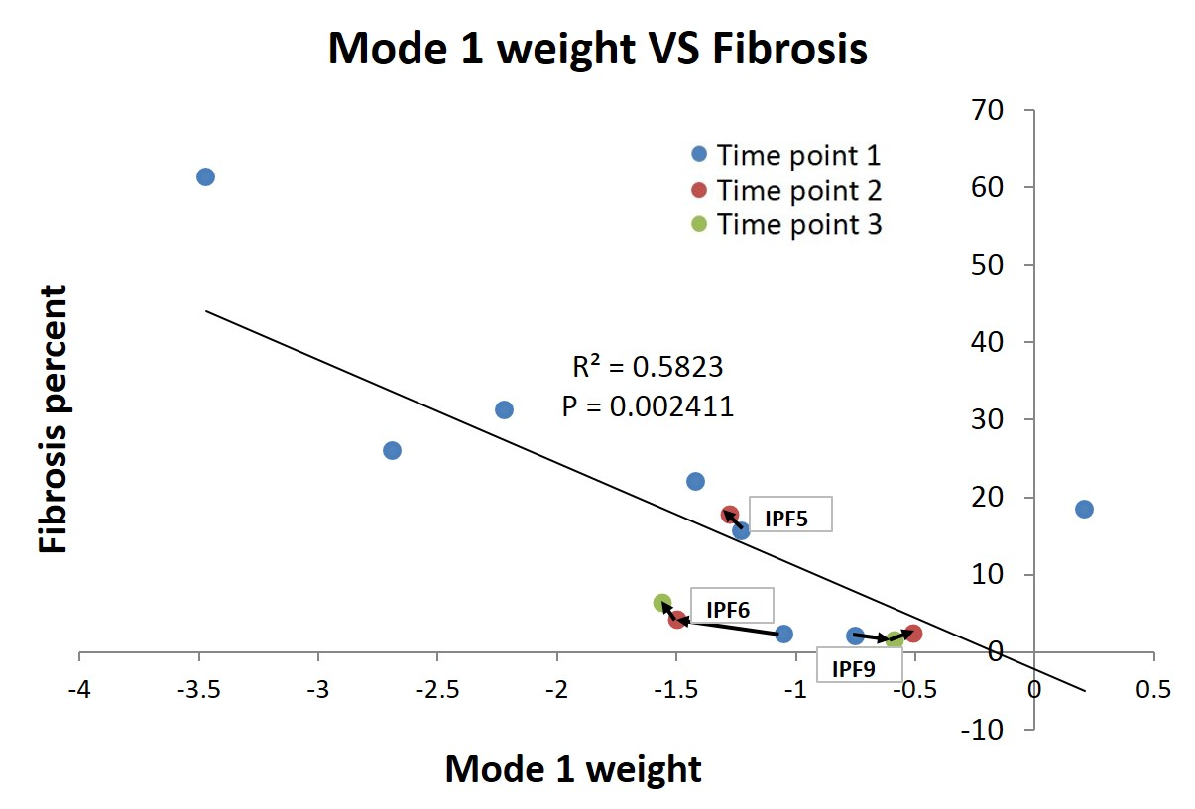
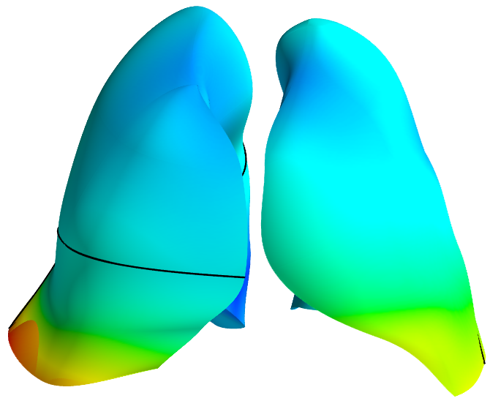
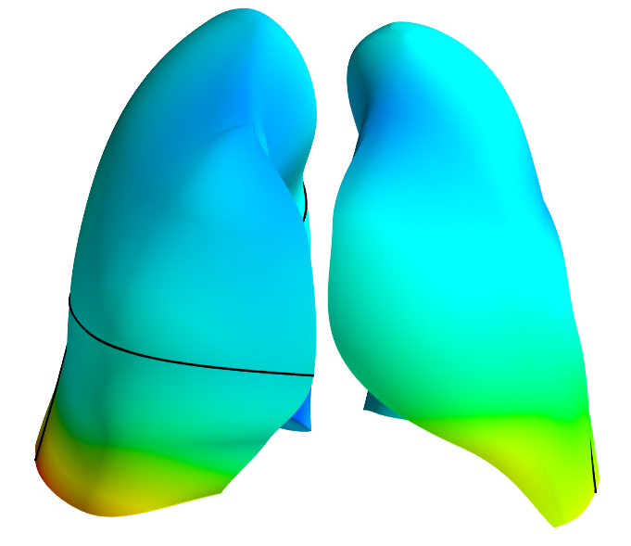
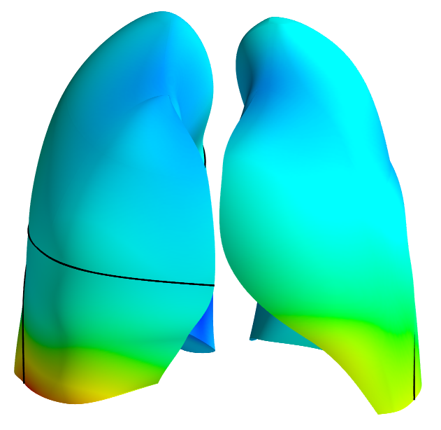
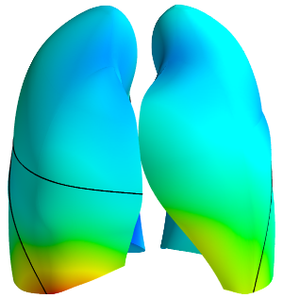
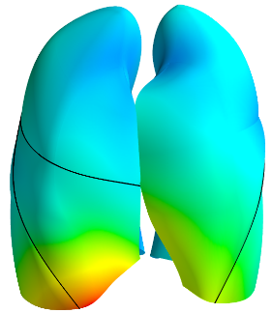
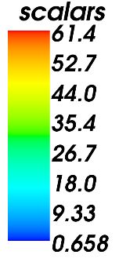
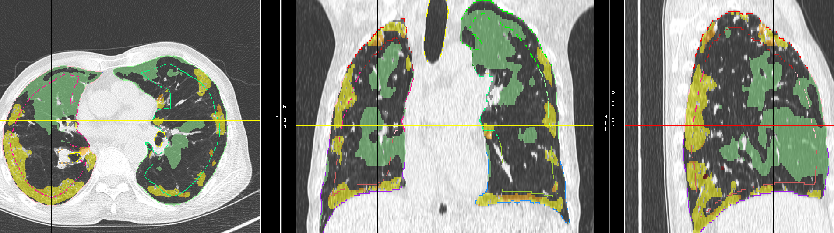
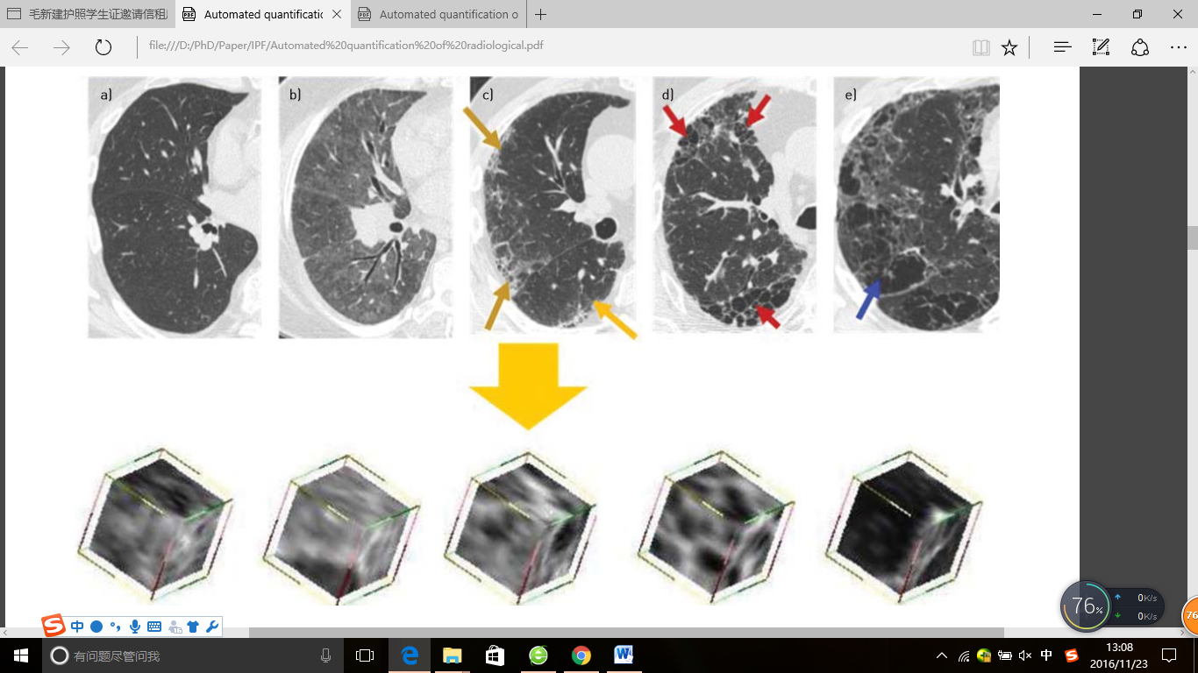
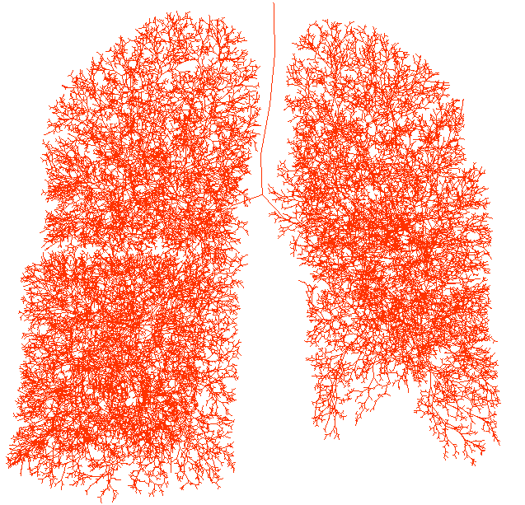
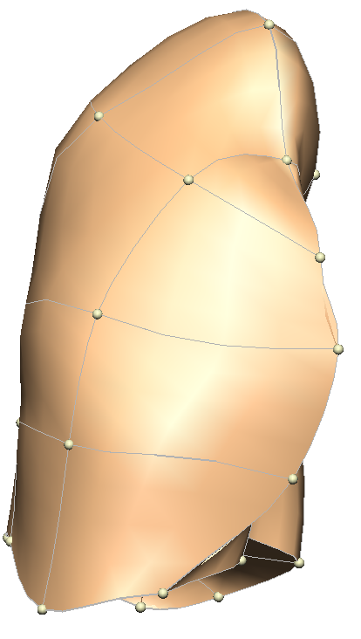
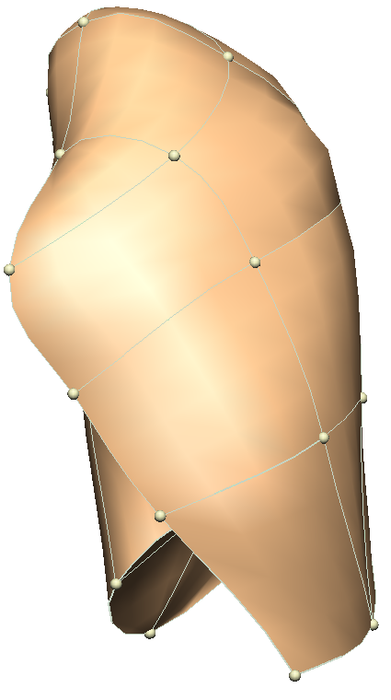
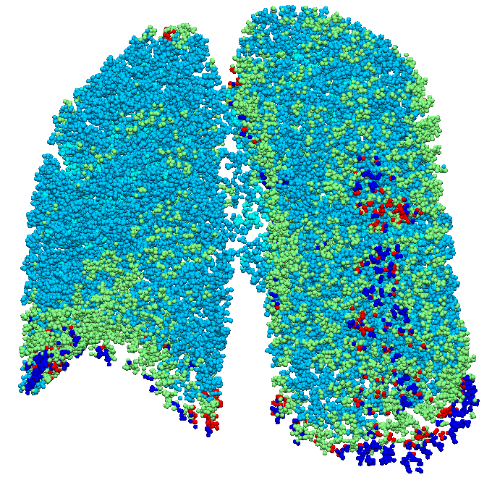
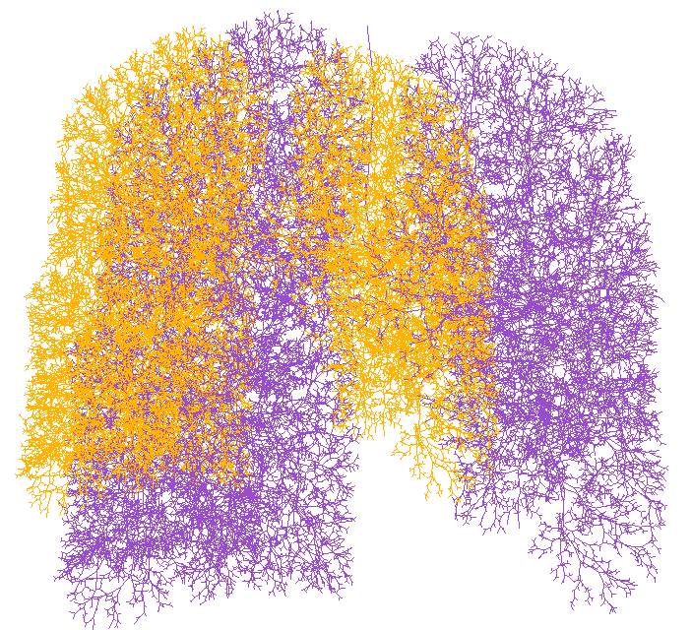
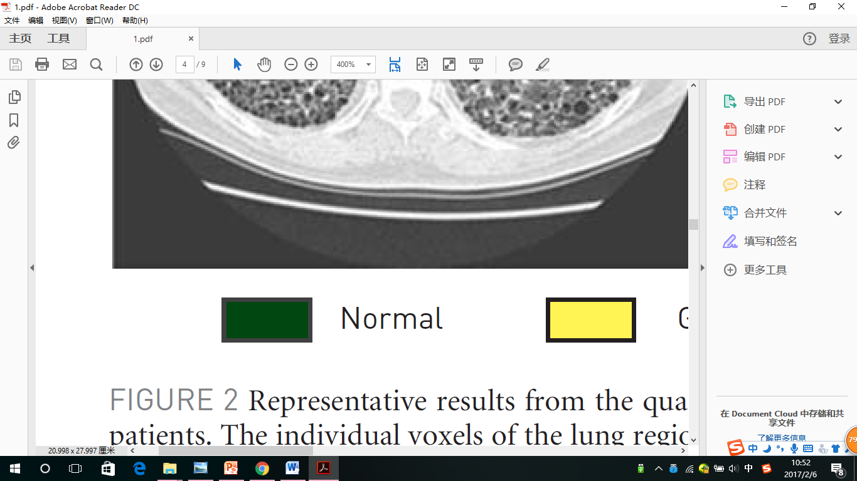
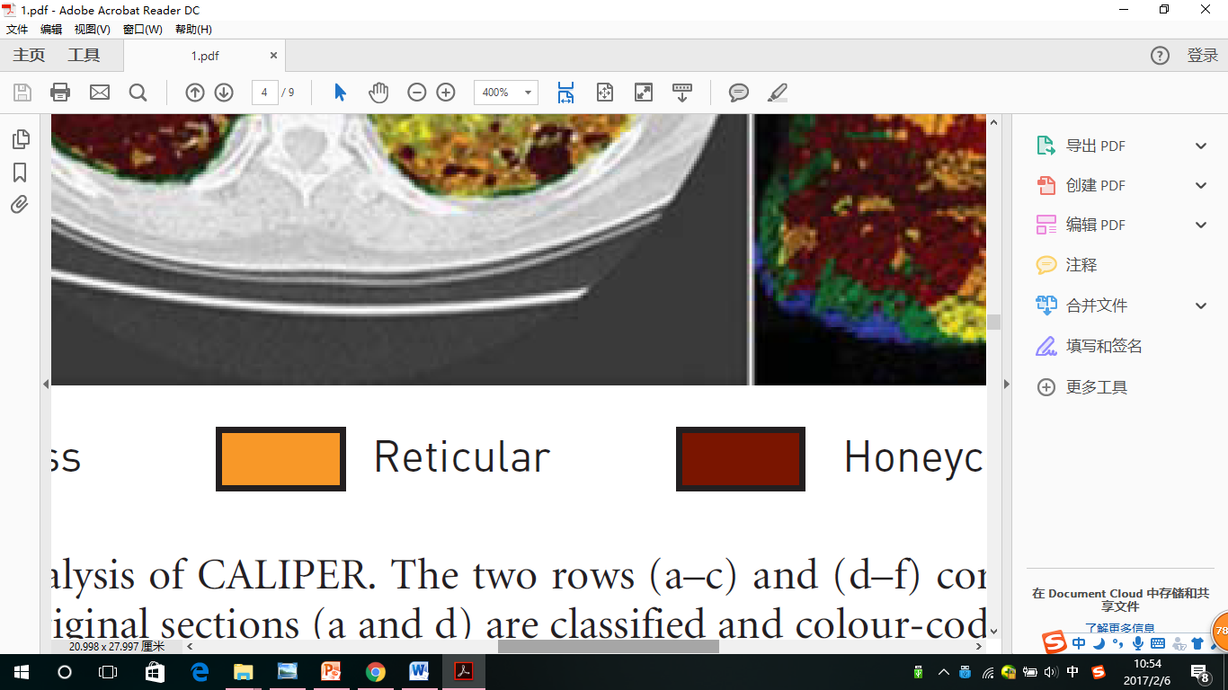
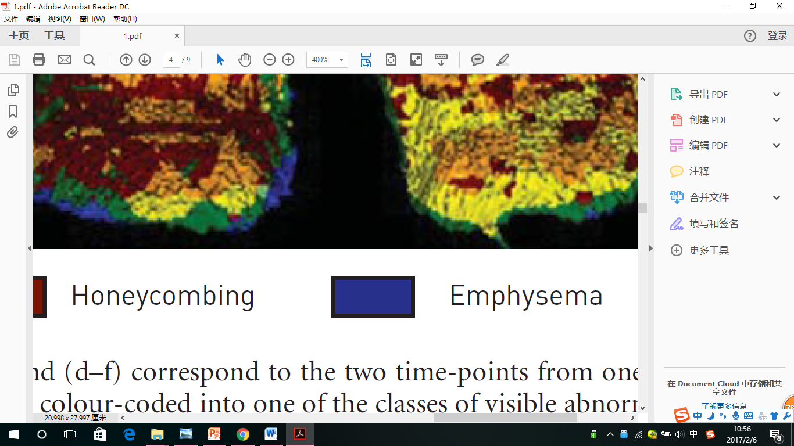
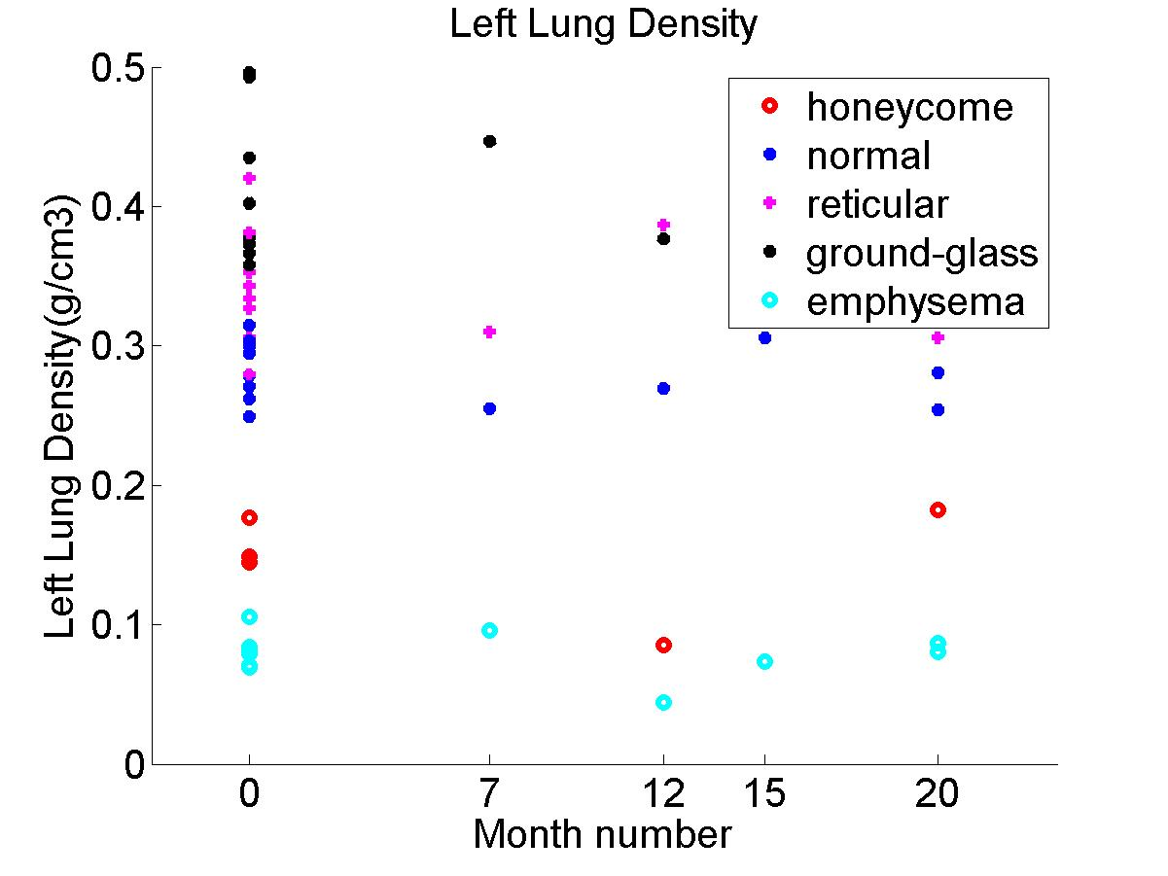
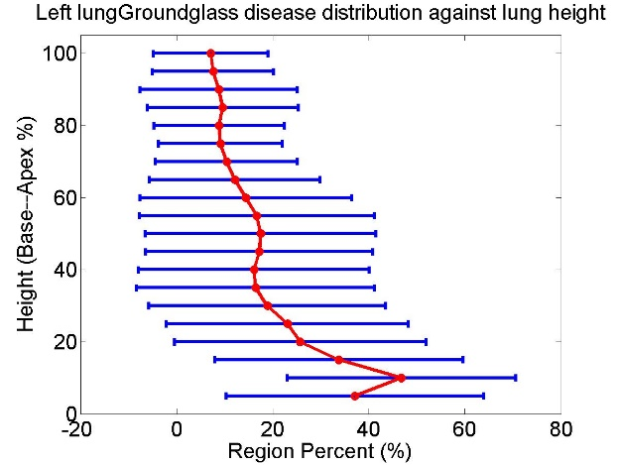
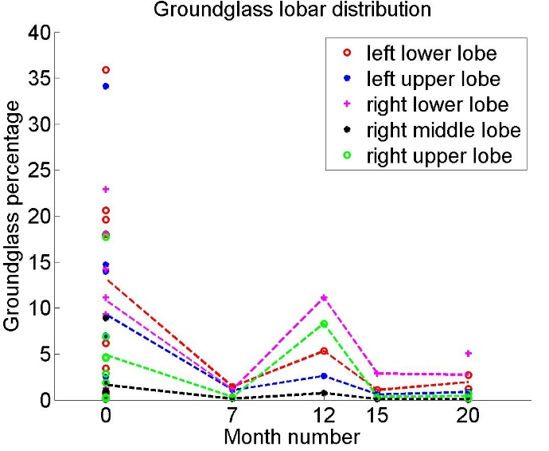
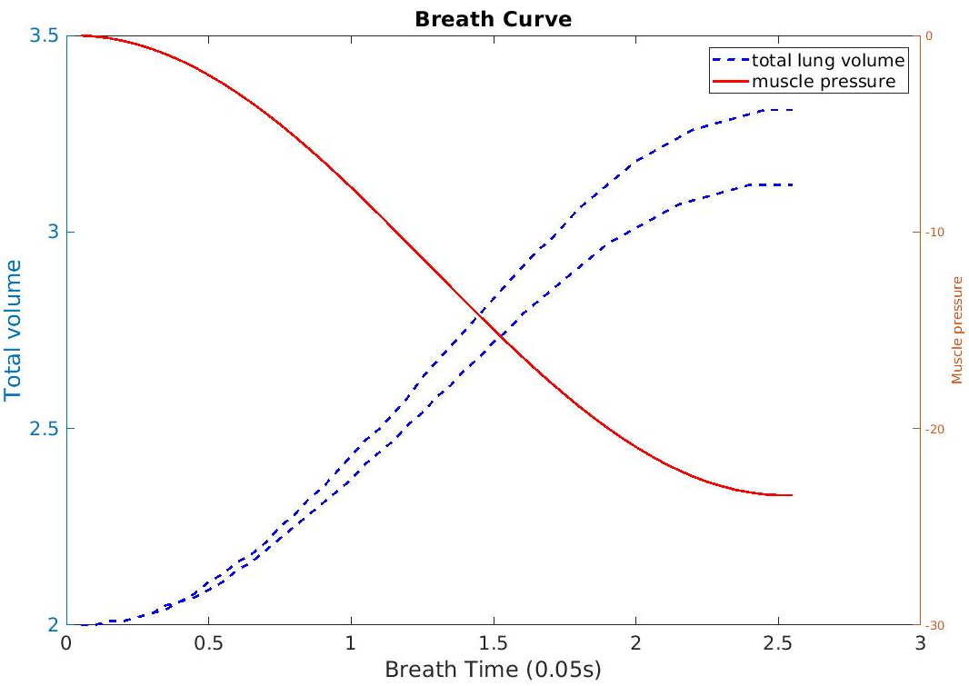
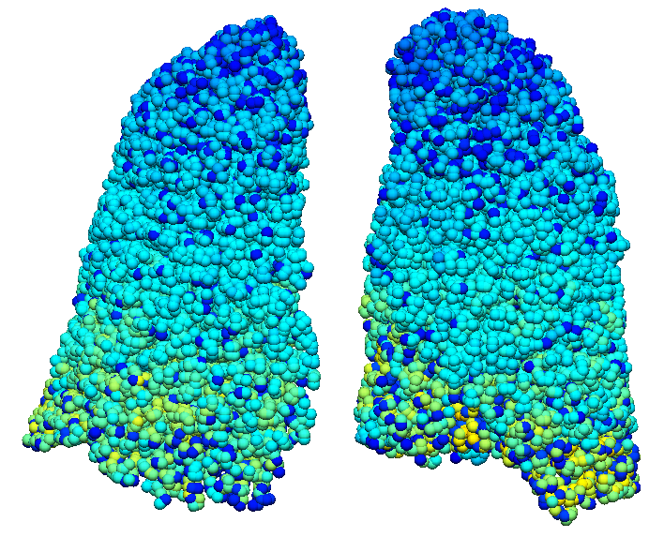
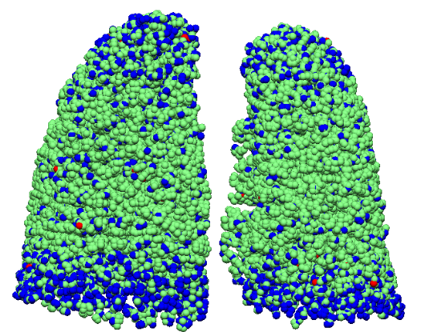
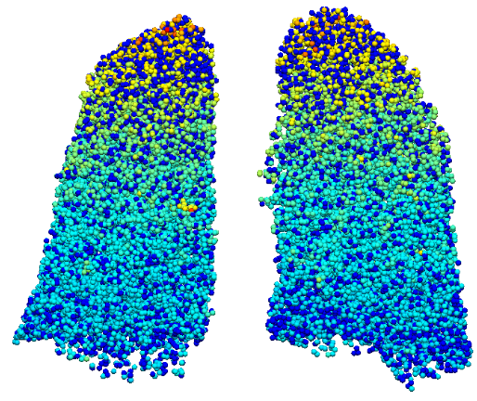
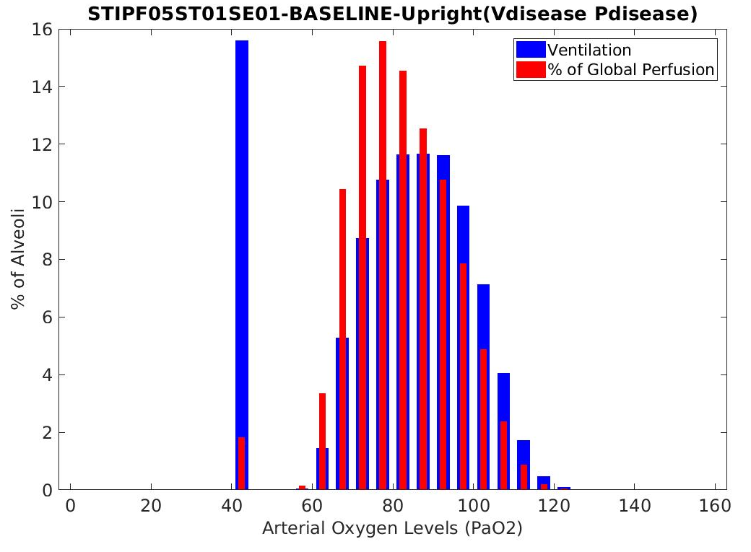
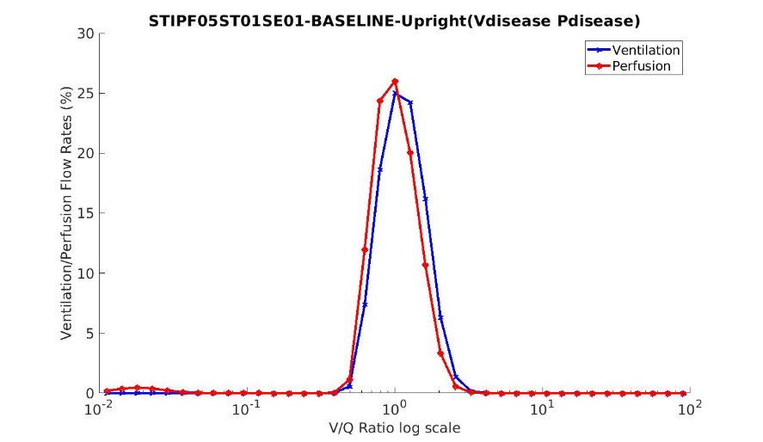
Idiopathic pulmonary fibrosis: a study using volumetric imaging and functional data in a computational lung model
Yuwen Zhang, Alys Clark, Haribalan Kumar , Merryn Tawhai, Auckland Bioengineering Institute, The University of Auckland, New Zealand
David Milne, Margaret Wilsher, Auckland City Hospital, Auckland, New Zealand
Brian Bartholmai, Department of Radiology, Mayo Clinic, Minnesota, US
Introduction
Analysis 2 Statistical shape model based shape analysis
Idiopathic pulmonary fibrosis (IPF) is an aggressive idiopathic interstitial pneumonia, and often occurs in elderly adults. In IPF, fibrosis typically develops preferentially in posterior-basal lung regions, and often co-exists with emphysema. Currently it is not clear how - or whether - the spatial distribution of tissue abnormalities in IPF (including classifications of tissue type) correlate with pulmonary function tests (PFTs) and their change over time. This work aims to develop a new quantitative tool that integrates data from volumetric imaging, PFTs, and computational models for lung function, to understand differences between IPF and normal older lungs.
Training data collection
Principle component shape feature analysis
Statistical shape model construction
Specific subject projection
The variation in shape of the lungs in the cohort can be assessed via a statistical shape model (SSM).
The most significant variation in shape (mode 1 of the SSM) relates to the anteroposterior diameter of the lung, and the ratio of apical and basal diameters
Mode 1 of the SSM is significantly different between IPF and normal subjects and correlates with percent of fibrosis (p<0.01).
There is a significant difference of right lower lobe volume and right middle lobe volume between normal old and IPF lungs (p=0.008168, 7.54E-07 respectively).
Tissue classfication
Data- Clinical IPF CT data from Auckland City Hospital 8 patients, 4 of them contain more than one time point scan for each
Mode1 -3 SD
Mode1 -2 SD
Mode1 0 SD
Mode1 1 SD
Mode1 3 SD
Pulmonary parenchyma classification - CALIPER (Computer-Aided Lung Information for Pathology Evaluation and Ratings) classification of abnormalities based on signature mapping techniques
Analysis 3 Patient-specific computational modelling of lung function
PFT results: FRC, TLC, DLCO, FEV1.
Step1: Airway and vessel tree generation with disease labeling
Normal Ground-glass Reticular Honeycomb Emphysema
Analysis Qantitative analysis of disease from classified data
Paramiterize
modeling
Tree generation
Tree mapping
Tree disease labelling
Tree scaling
Step 2: Ventialtion and perfusion simulation
Parameterize
modeling
Physiological knowledge of IPF patients: increased airway volume and vessel volume, decreased dead space, lung compliance and diffusion capacity
Simulated firbrosis distribution
Inhale volume and pressure curve
Disease perfusion distributiond
Summary
Fibrosis has a consistently higher tissue density (0.34/0.41 for reticular/ground-glass) compared to normal tissue (0.28) over time. In contrast, emphysema has lower density (0.08)
The percentage of ground-glass decreases gradually with increasing lung height in the cranial-caudal axis. In contrast, the percentage of emphysema increases with lung height.
Fibrosis presents predominantly in lower lobes (72%, 58%, 65% for honeycomb, reticular, ground-glass). But emphysema appears predominantly in upper lobes (73%).
We classified the pulmonary parenchyma representing IPF features and performed quantitative analysis of IPF lungs.
Quantitative analysis combined with PFTs were used to drive a patient-specific computational modelling of lung function.
A future work is to explore the relationship between V/Q mismatching and disease distribution
Step 3: V/Q distribution (gas transfer modeling)
V/Q distrubution
PaO₂ distribution
MIGET plot
Acknowledgements – Clinical data for this study was provided by Drs ML Wilsher and DG Milne, Auckland City Hospital; CALIPER analysis was conducted by Dr B Bartholmai, The Mayo Clinic.

